Slide 1
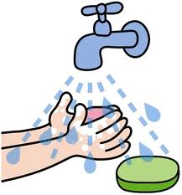
Why do we wash our hands?

Slide 2

Why do we brush our hair?

Slide 3
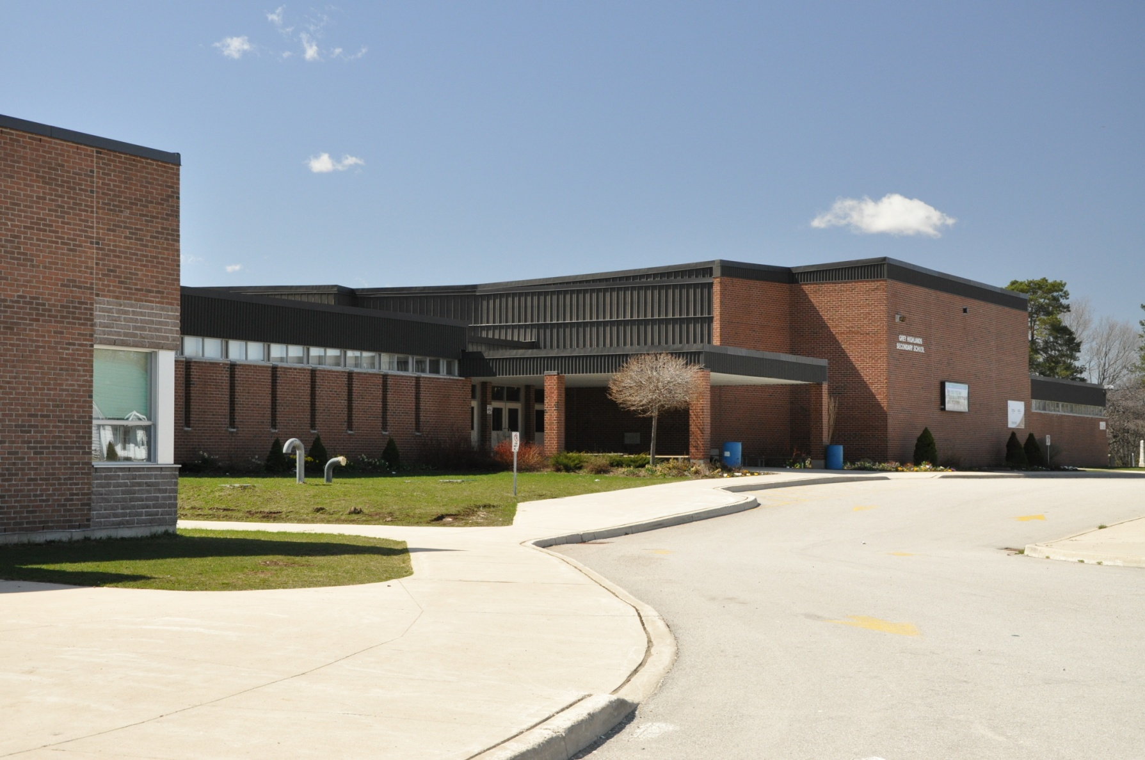
Why do we go to school?

Slide 4
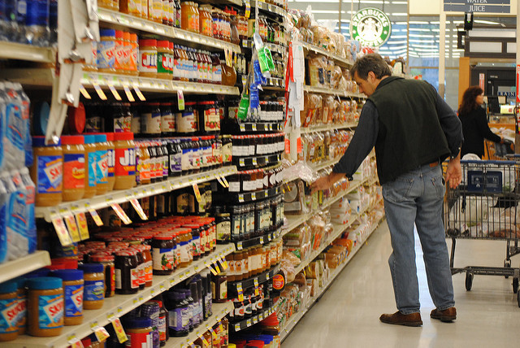
Why do we go to the supermarket?

Slide 5
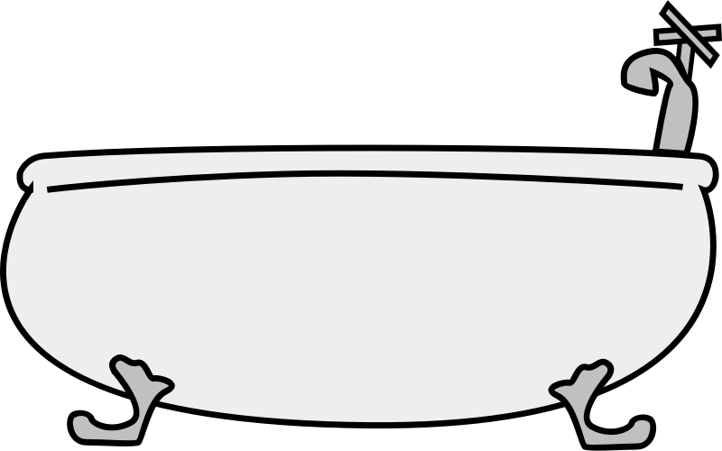
Why do we have a bath?

Slide 6
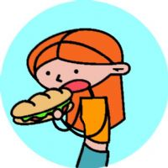
Why do we eat food?

Slide 7

Why do we go places in the car?

Slide 8
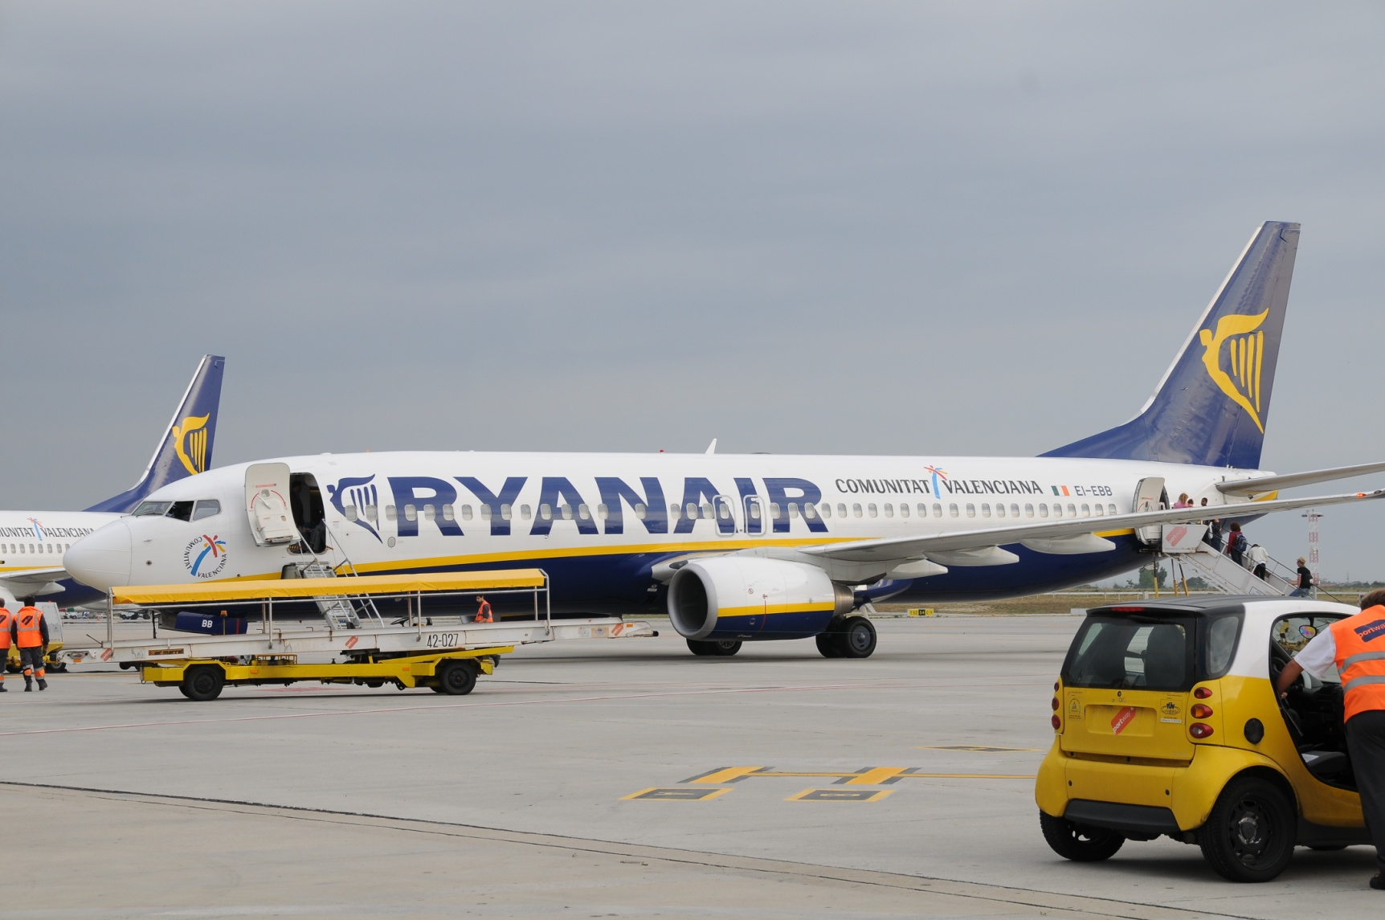
Why do we go on aeroplanes?

Slide 9
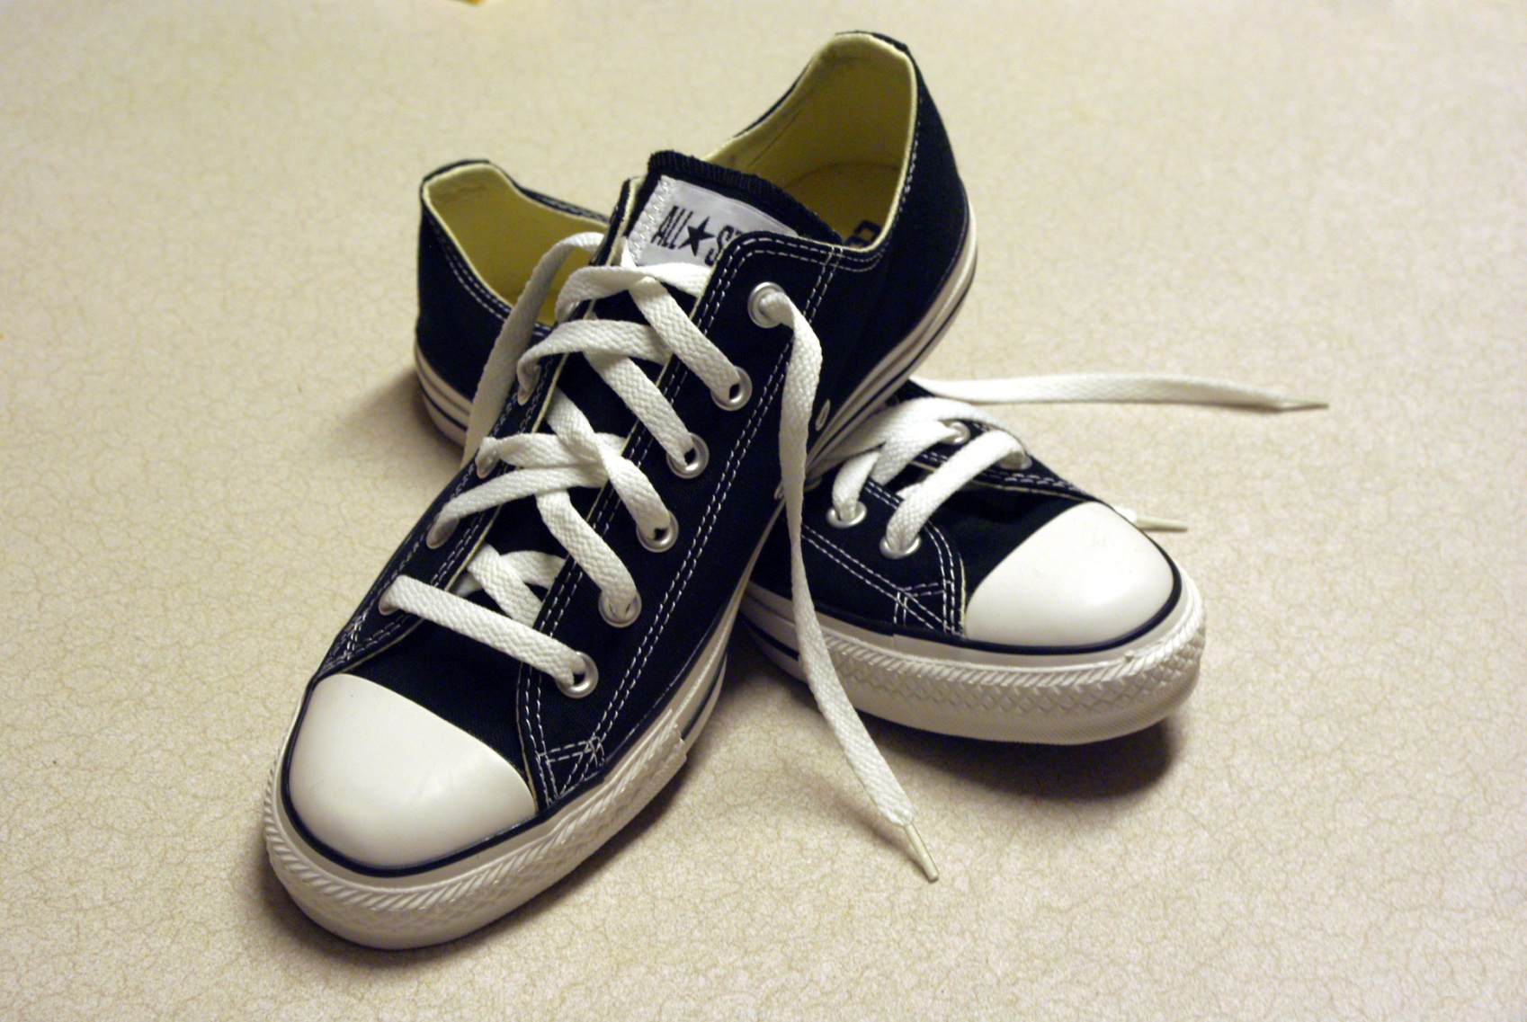
Why do we wear shoes?

Slide 10
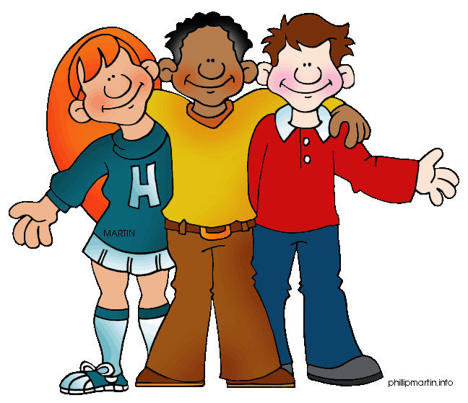
Why do we have friends?

