Slide 1

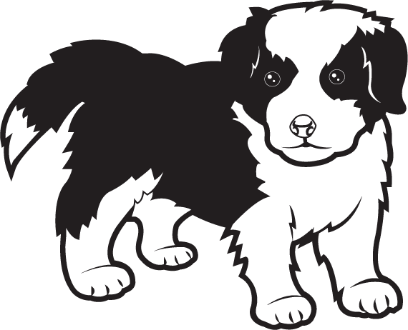
Where is dog?
Can you find him?

Slide 2

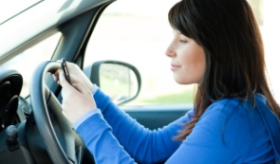
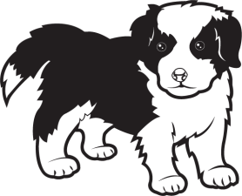
Where is dog?

Slide 3
Dog is in front of the car.

Slide 4

Where is dog?

Slide 5
Dog is in front of the box.

Slide 6

Where is dog?

Slide 7
Dog is in front of the flower pot.

Slide 8

Where is dog?

Slide 9
Dog is in front of the cup.

Slide 10
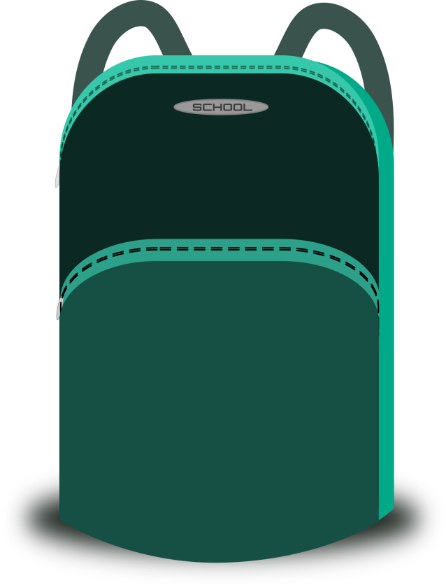
Where is dog?

Slide 11
Dog is in front of the bag.

Slide 12

Well done

